Slide 1
Distributed Databases
Reference: Chapter 12

Slide 2
Topics to be Covered
what is a distributed database?
how do you distribute the data in a distributed database?
architecture of a distributed database system and expected features
query optimization and transaction management in a distributed system

Slide 3
What is a distributed database?

Slide 4
Definitions
centralized database: one database that might be accessed from remote locations
distributed database: a single logical database that is spread physically across computers in multiple locations that are connected by a data communications link
note that distributed processing is not the same as a distributed database

Slide 5
Distributed Processing
distributed processing occurs when the logical processing for a database is shared between two or more physically separate computers connected through a network
the database may reside on a single computer
in this case, the processing is distributed, but the database is not

Slide 6
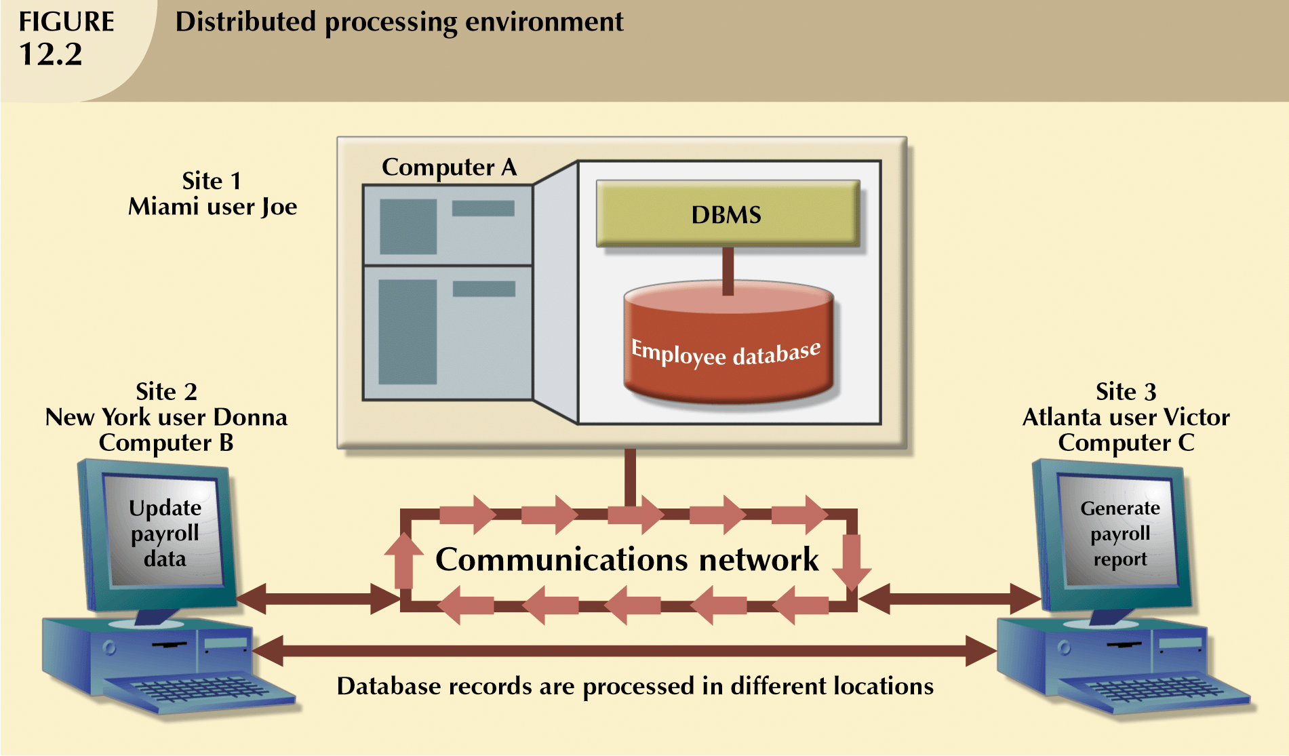
Distributed Processing

Slide 7
Distributed Database
a distributed database stores a logically related database over two or more physically independent computers, connected by a network

Slide 8
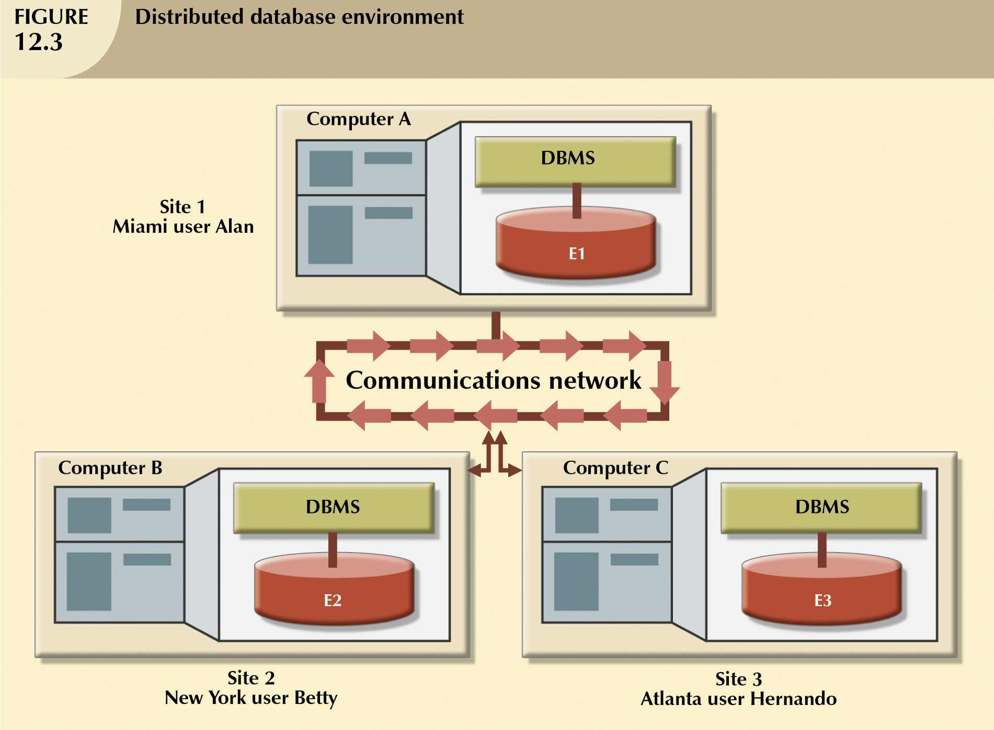
Distributed Database

Slide 9
Distributed Database
note that in a fully distributed database, both processing and data are distributed

Slide 10
Advantages of Distributed Databases
compared to centralized databases, distributed databases offer a number of advantages
data can be located closer to its point of use; this results in
lower communication costs
faster data access for end users when using the locally stored data

Slide 11
Advantages of Distributed Databases
data processing is faster because data is processed by multiple processors at multiple sites
growth is facilitated because new sites can be added easily and with no disruption to other sites
operating costs may be reduced because it is generally more cost-effective to add workstations to a network than it is to update a mainframe system

Slide 12
Advantages of Distributed Databases
reliability is increased because
the system can continue to function even when a component fails
the data is distributed at multiple sites so if one component fails, it does not result in all of the data being unavailable

Slide 13
Disadvantages
there are also some disadvantages
software cost and complexity
applications must be able to aggregate data from different locations
database administrator must be able to coordinate activities between sites to ensure that performance does not degrade (for example, if data is not distributed correctly, service may be poor)

Slide 14
Disadvantages
technical difficulty
all of the problems that are present with centralized databases (data integrity, transaction management, concurrency control, security, backup, query optimization, recovery, for example) must be dealt with in a distributed environment; the more complex environment makes all of these problems more difficult to deal with and increases the risk of errors

Slide 15
Disadvantages
lack of standards
there are no standard communication protocols at the database level – different vendors use different, and sometimes incompatible techniques for managing distributed data
increased storage requirements
data may be duplicated at multiple sites, requiring additional storage capabilities

Slide 16
Disadvantages
training costs may be higher because of the added complexity of a distributed system
infrastructure costs are generally higher because of duplicated infrastructure (physical location, personnel, software, licensing, hardware, etc.) at multiple sites

Slide 17
Distributed Database Options
Distributed Databases
data distributed across all nodes
Homogeneous
Heterogeneous
same DBMS used at each node
different DBMSs used at different nodes

Slide 18
Homogeneous Distributed Databases
homogeneous distributed databases
use the same DBMS at each node
are simpler to manage than heterogeneous distributed databases
it is generally difficult to force a homogeneous environment in a large organization

Slide 19
Heterogeneous Distributed Database
heterogeneous distributed databases
may use different DBMS at each node
are much more complex to manage
are common in large corporations because of pre-existing department-level databases, already set up using different DBMSs, and the reluctance of individuals to change to a new system

Slide 20
How do you distribute data in a distributed database?

Slide 21
Distributed Database
in a distributed database, the database is composed of several parts, called database fragments
these database fragments are distributed among the physical computers in a variety of ways

Slide 22
Distributing the Data
data replication
horizontal fragmentation
vertical fragmentation
mixed fragmentation

Slide 23
Replicated Data
with replicated data, a separate copy of all or part of the database is stored at two more sites
replicated data must adhere to the mutual consistency rule
all copies of data fragments must be identical

Slide 24
Replicated Data
replicated databases may use either synchronous or asynchronous technology for updates

Slide 25
Synchronous Updates
with synchronous updates
data updates are immediately applied to all copies throughout network
copies of the data are always identical
good for data integrity
high overhead because of the time required to check that an update is accurately propagated throughout the network
slow response time because of high overhead

Slide 26
Asynchronous Updates
with asynchronous updates
data update propagation is delayed
some data inconsistency is tolerated
lower data integrity
less overhead and therefore faster response time

Slide 27
Data Replication Advantages
advantages of data replication include
reliability – if one site fails, data is available at another site
fast response – each site with a local copy of data will have quick response to select queries
de-couples nodes – transactions proceed even if some nodes are down
reduces network traffic at prime time if updates can be delayed

Slide 28
Data Replication Disadvantages
disadvantages of data replication include
additional requirements for storage space
additional time for update operations
complexity and cost of updating
integrity issues if replicated data is not updated simultaneously

Slide 29
Horizontal Fragmentation
with horizontal fragmentation
different rows of a table are at different sites
the rows at the different sites all contain the same columns

Slide 30
Horizontal Fragmentation-Advantages
advantages of horizontal fragmentation:
data are stored close to where they are used, resulting in efficiency and better performance
only relevant data are available, so security is better
it is easy to perform unions across horizontal fragments, so querying is easy

Slide 31
Horizontal Fragmentation-Disadvantages
disadvantages of horizontal fragmentation:
accessing data across fragments results in inconsistent access speed
with no data replication, there is increased vulnerability, especially if proper backups are not performed at each site

Slide 32
Vertical Fragmentation
with vertical fragmentation
different columns of a table at different sites
advantages and disadvantages are the same as for horizontal fragmentation except that combining data across fragments is more difficult because it requires joins (instead of unions)

Slide 33
Mixed Fragmentation
mixed fragmentation involves both vertical and horizontal partitioning
a subset of rows may be selected to reside at a site
however, only selected columns will reside at the site
a second site might have the same set of rows, but different columns (or different rows and columns)

Slide 34
The Right Strategy?
the distribution strategies described above are most commonly used in combination with each other
the “best” strategy depends on funding availability, security needs, performance requirements, existing hardware and software, and many other factors

Slide 35
Architecture of a distributed database and expected features

Slide 36
Distributed DBMS (DDBMS)
in a distributed database, there is a DBMS at each local node
there must also be a DBMS that coordinates the entire system
such a DBMS is called a distributed DBMS (DDBMS)

Slide 37
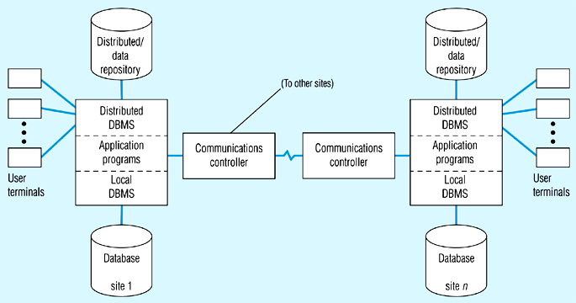
Ref: Hoffer, J., Prescott, M., McFadden, F. Modern Database Management, 7th ed. Prentice-Hall (2004), p. 562.

Slide 38
DDBMS Required Functions
almost all DDBMSs provide the following services
maintain a distributed data dictionary
determine locations from which to retrieve data and process query components
translate between nodes with different local DBMSs and data models

Slide 39
DDBMS Required Functions
provide data management functions, such as security, concurrency, query optimization, failure recovery
ensure consistency among copies of the data
present a single logical database to the user
DDBMSs are also expected to have certain transparency features

Slide 40
Transparency Features
location transparency
user/application does not need to know where data resides
queries are constructed as though all the data is local
except for response time, the user should see no difference in querying local or remote data

Slide 41
Transparency Features
fragmentation transparency
user/application does not need to know that the database is fragmented
replication transparency
replicated data is transparent to the user
both fragmentation and replication transparency ensure that, to the user, the database looks like a single, logical database

Slide 42
Transparency Features
transaction transparency
with transaction transparency, either all the actions of a transaction are committed or none are committed
DDBMS at each site has a transaction manager that
logs before and after images of each transaction
ensures that all update operations are synchronized to maintain data integrity

Slide 43
Transparency Features
failure transparency
the DDBMS is responsible for database recovery when a failure occurs
performance transparency
query optimization is more complicated in a distributed database system
the DDBMS must determine an access plan
in the case of replicated data, an important component of the access plan is to determine which data will be retrieved from which site

Slide 44
Query optimization and transaction management in a distributed system

Slide 45
Query Optimization in a DDBMS
a DDBMS typically uses a three-step process for query optimization
query decomposition -- simplify and rewrite into a structured, relational algebra form
data localization -- fragment the query so that each fragment references data at a single site
global optimization -- determine
the order in which to execute the query fragments
where to move data between sites
where each part of the query will be executed
this process should be transparent to the user

Slide 46
Distributed Concurrency Control
in a distributed, multi-user environment, an important part of transaction transparency is concurrency control
a transaction may access data at multiple sites
a final commit cannot be executed until all sites have committed their part of the transaction
a DDBMS always has a well-defined commit protocol to ensure concurrency control

Slide 47
Types of Transactions
there are four levels of transactions possible for distributed databases
remote requests (level 1)
remote transactions (level 2)
distributed transactions (level 3)
distributed requests (level 4)

Slide 48
Remote Request & Transaction
a remote request (level 1) is a single SQL statement that accesses data on only a single site
a remote transaction (level 2) also accesses data on a single remote site, but the transaction may consist of more than one SQL statement
the entire transaction must access only a single site

Slide 49
Distributed Transaction
in a distributed transaction (level 3)
a transaction can reference multiple database sites
however, each individual SQL statement in the transaction can reference only one database site

Slide 50
Distributed Request
in a distributed request (level 4)
a transaction can reference multiple database sites
individual SQL statements in the transaction may reference multiple database sites
fully supports location transparency

Slide 51
Distributed Databases
The End

